Slide 1
How to use this deck
INTERNAL • REMOVE BEFORE SHARING
START HERE
Customize this deck to your client needs
1
Tell the complete platform story
2
Lead with the client’s priority
Best when the client needs the full platform narrative or you are still exploring priorities.
Start with slides 2-11 and jump from the platform foundation to the most relevant module chapter.
Observe
Slide 21
OR
Continue through slides 2–16
Observe for network teams
Slide 29
Protect
Slide 34
Short on time? Skip slides 5 and 8–10.
Optimize
Slide 41
IBM Concert platform
1
Notes:
You can customize this 101 deck to meet your needs.
You can use it to tell the full Concert platform story – using slides 2-16 in order
Or, if you know your client is interested in a particular capability you can use those slides to tell a more focused story.
Just start with slides 2-11 and then jump to the individual slides for that capability, listed here.

Slide 2


IBM Concert platform
Turn operational complexity into governed, coordinated action
Build cross-domain context to improve performance, reduce risk, and strengthen resilience.
Speaker name
Designation
IBM
Notes:
Hi everyone, thank you for joining today. I’m ______ and I work on IBM Concert.
Before we start, I want to frame what this is really about.
The operational challenges we're seeing across enterprises aren’t a problem with tooling, they are a problem with the operating model.
That problem can be addressed by shifting from managing individual tools, to managing systems.
So lets dive in.

Slide 3

IT complexity is compounding across every operational domain
Autonomous activity expands.
Cross-domain dependencies multiply.
150,000+
Operational pressure intensifies.
Projected AI agents in use at an average global Fortune 500 enterprise by 2028 — up from fewer than 100 in 2025.
Source: Gartner, “Gartner Identifies Six Steps to Manage AI Agent Sprawl,” April 28, 2026.
IBM Concert platform
Notes:
Quick context. IT environments have always been complex, and that complexity is compounding across every operational domain. AI agents add another layer — not simply more software to monitor, but systems that can observe, decide, and act on their own.
Gartner projects that an average global Fortune 500 enterprise will have more than 150,000 agents in use by 2028, up from fewer than 15 in 2025.
The number is striking, but the operational implication matters more.
Each agent can access data, call tools, generate activity, and trigger changes across applications, infrastructure, security, and service management. Even when individual agents work as intended, their combined activity creates a much larger and faster-moving environment to understand and govern.
As autonomous activity expands, cross-domain dependencies multiply. An action taken in one part of the environment can affect performance, risk, cost, or resilience somewhere else.
Without shared context and coordination, operations teams become the manual coordination layer — reconciling signals, decisions, and controls after the fact.

Slide 4



Human coordination cannot scale with today’s operational complexity
Speed
Risk
Cost
70%
of tech leaders say teams deploy faster than IT can track.¹
90x more
working cyberattack code generated by Anthropic’s Mythos AI model.²
3x
global AI infrastructure spending by 2029 vs 2025—surpassing $1T+ amid power and component constraints.³
Source:
1 IBM Institute for Business Value, “2026 Tech Leader Study: Building the IT foundation for agentic AI at scale,” June 2026.
2 Anthropic, “Assessing Claude Mythos Preview’s Cybersecurity Capabilities,” April 7, 2026.
3 IDC, “AI Infrastructure Spending Holds Near $90 Billion in Q1 2026,” July 2026..
IBM Concert platform
Notes:
And that is where the current operating model starts to break down. Human coordination simply cannot scale with this level of complexity.
We can see the pressure in three areas: speed, risk, and cost.
On speed, 70% of technology leaders say teams are deploying faster than IT can track. Changes are entering the environment faster than teams can understand their dependencies and impact.
On risk, Anthropic’s Mythos model generated roughly 90 times more working exploits than the previous model. AI is rapidly shrinking the window to assess what is exploitable and remediate it before an attacker can act.
And on cost, IDC projects global AI infrastructure spending will more than triple by 2029, surpassing $1 trillion. With limited power availability and shortages of critical components making new capacity harder to add, organizations need to get more from the infrastructure they already have.
These may look like separate challenges, but they converge in the same operational environment.
The tools are not absent. Coordinated action is.

Slide 5
The operating model must change
From fragmented tools and teams → coordinated, governed action at scale
IBM Concert platform
Notes:
This is why the operating model has to change.
Waiting isn’t an option:
Complexity will keep growing, but the way teams coordinate today simply can’t scale with it. Every new system, signal and tool creates another handoff, another decision, and more time before action happens.
Organizations need to move from fragmented tools and teams to coordinated action at enterprise scale.
This is not simply about centralizing more data or adding another dashboard. It is about changing how work moves from signal, to decision, to execution — before the gap between what teams can see and what they can act on gets wider.

Slide 6
One operating model.
Continuous action.
IBM Concert platform
1
Understand →
2
Decide →
3
Act →
Across domains
Faster, with confidence
With governance and control
IBM Concert platform
Notes:
And that is where IBM Concert comes in.
IBM Concert is IBM’s new IT operations platform, which brings together capabilities for observability, resource optimization, operations, risk, resilience, and automation.
Concert creates one continuous operating model across three connected motions: Understand, Decide, and Act.
Understand establishes context across domains. Decide applies business impact, policy, and domain expertise to determine what matters. Act turns that decision into governed execution at enterprise scale.
The value comes from connecting all three. Concert does not stop at visibility or recommendation. It helps teams move continuously from shared context to coordinated action across domains and teams.

Slide 7


















Break down silos. Coordinate trusted action.
UNDERSTAND
Across domains
DECIDE
Faster, with confidence
ACT
With governance and control
Technology Estate
Business Outcomes
IBM Concert platform
Application
Observe
Protect
Optimize
Increased speed
Security
Infrastructure
Reduced risk
Network
Operate
Resilience
Workflows
Reduced cost
ITSM, alerts and incidents
IBM Concert platform
Notes:
So how does Concert put that operating model into practice?
It starts with the technology estate you already have. Applications, infrastructure, networks, security, service management, and observability tools are all generating signals and carrying out work.
Concert connects the relevant information from across that environment to give domain-specific context. That context gives its capabilities a connected understanding of what is happening, what is affected, and why it matters.
From there, Concert brings together capabilities for Observe, Optimize, Operate, Protect, Resilience, and Workflows. Each contributes specialized expertise, but they do not operate as separate silos. They work from shared context to inform decisions across performance, cost, risk, resilience, and incident response.
Concert then carries those decisions into the systems and workflows already responsible for the work. Policies, approvals, and guardrails determine what can happen automatically and where people need to remain involved.
The result is a faster path from signal to resolution, with less manual coordination, lower operational risk, and more efficient use of resources.
And clients do not need to adopt every capability at once. They can start with the priority that matters most, then extend the same operating model across additional use cases over time.
Transition if continuing to 8-10:
Let’s look more closely at how Concert builds the shared context that makes those cross-domain decisions possible.
Transition if skipping slides 8-10:
Let’s see how that comes together when a critical business service begins to fail.

Slide 8

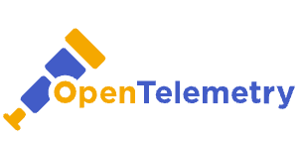

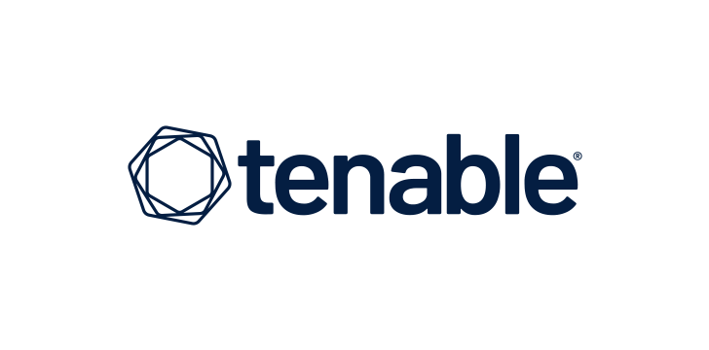




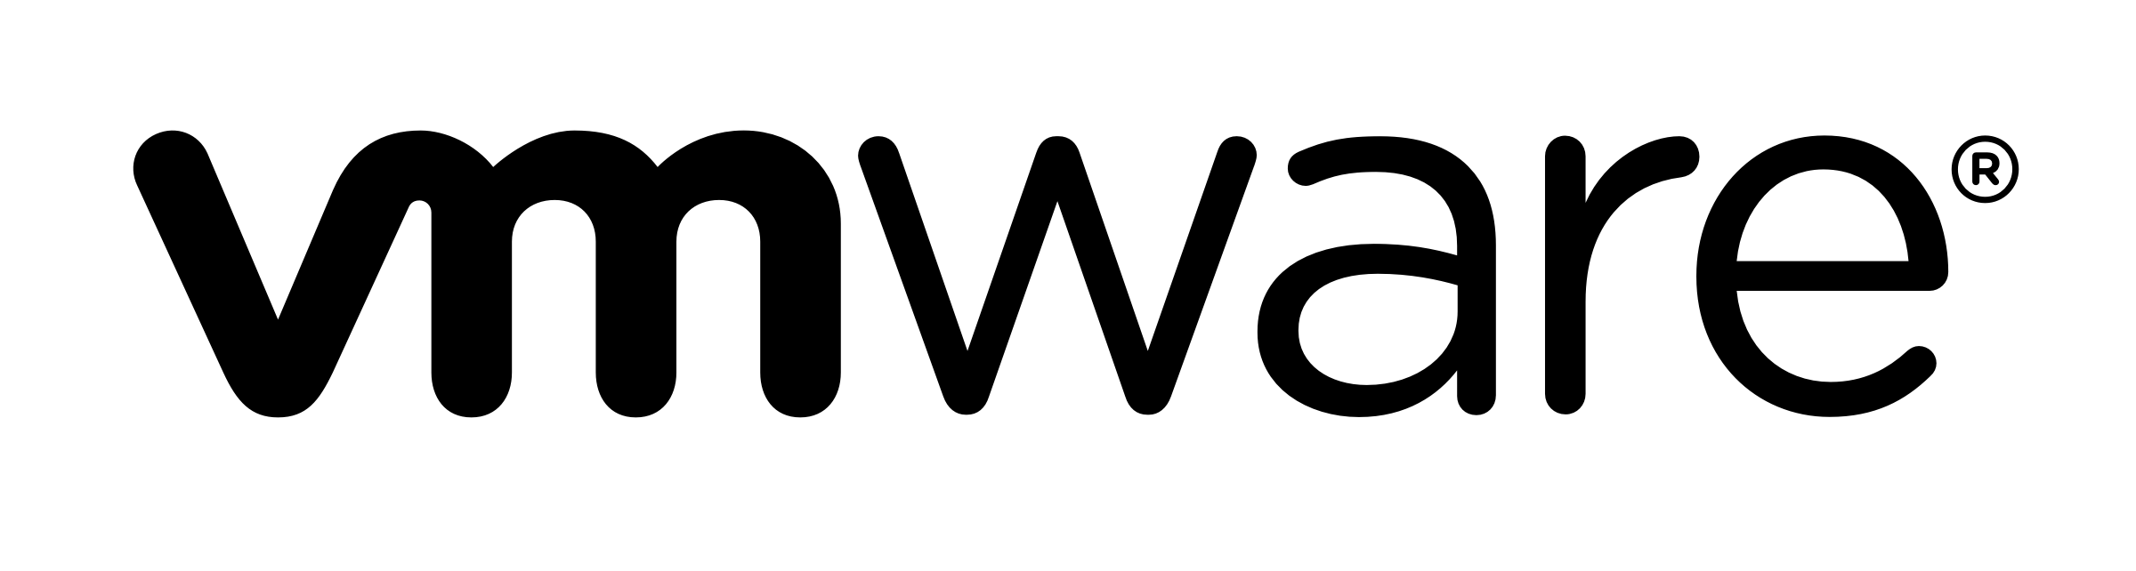











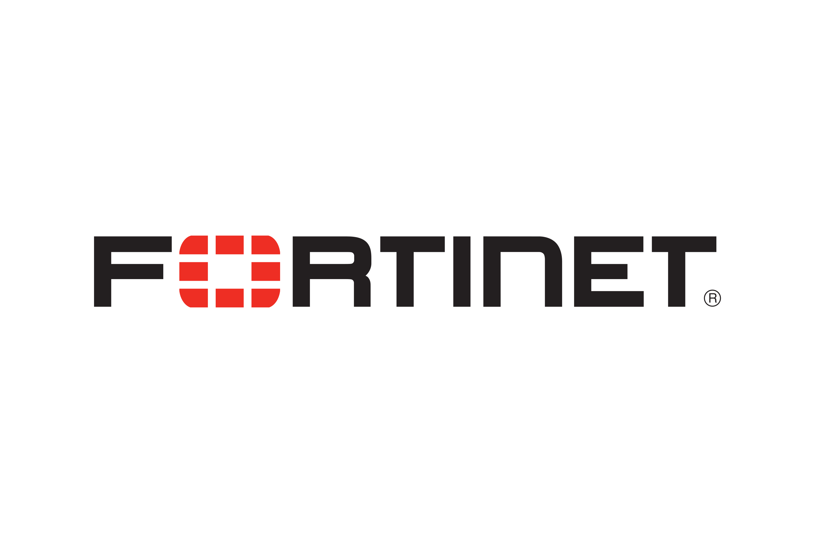
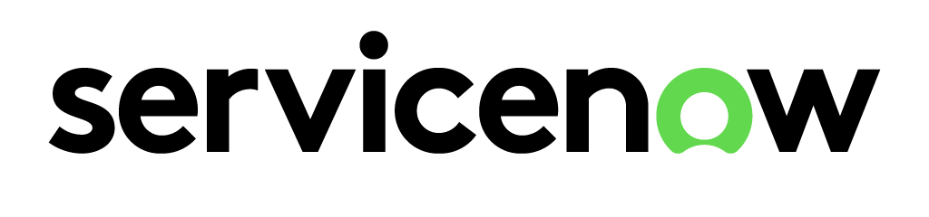














Seamlessly integrate data & signals into domain knowledge
UNDERSTAND
200+ integrations across IBM and 3rd party tools
Application
IBM Concert platform
Security
Observe
Protect
Optimize
Infrastructure
DATA + SIGNALS
Operate
Resilience
Workflows
Network
ITSM, alerts and incidents
Each Concert capability applies domain-specific data and intelligence
IBM Concert platform
IBM Concert platform
Notes:
Understand is the first building block in the Concert operating model. It connects signals across your technology estate to create shared context across applications, infrastructure, networks, security, and service management.
With more than 200 integrations across its capabilities and an open ecosystem, Concert can bring in relevant data and signals from the IBM and third-party tools you already use. This gives each Concert capability a broader understanding of your environment.
Today, that shared context powers cross-domain agentic workflows across Concert Observe and Optimize — helping these capabilities work together with a more complete understanding of what is happening and why it matters.
Our direction is to extend this coordination model across additional IBM technologies and third-party tools and agents — expanding the ecosystem from contributing context to participating in agentic workflows.

Slide 9
DECIDE
Know what matters across domains, with context
Unified AI Assistant
Single interface for operational direction, questions, insights, and actions​
Coordinator Agent
Acts as the operational manager, synthesizing expertise across
domains to drive coordinated decisions​
Capability Agents
Specialized agents that investigate, prioritize, and execute across operational domains​
Observe
Protect
Optimize
Incident Investigation
Secure Coder
SLO
And more
Domain Knowledge
Data access layer
IBM Concert platform
Notes:
Once Concert has context, the next question is: what matters most across the environment, and what should happen next?
That’s what Decide is about.
Users interact through the Unified AI Assistant to investigate issues and review recommendations.
Behind it, Capability Agents contribute specialized expertise from observability, security, infrastructure optimization, and other operational domains.
The differentiation comes from the Coordinator Agent. It brings those perspectives together, maintains shared context, and evaluates cross-domain tradeoffs — not just what is best for one team or tool.
For example, an infrastructure change that reduces cost could affect the performance or security of a critical service. Concert helps teams account for those dependencies, policies, and business impacts so they can prioritize what matters across the entire environment.

Slide 10





Coordinate governed action across domains
ACT
Agentic Execution
- Execute approved tasks through domain agents and workflows
Application Delivery
- IDE remediation
- Patch application
Security Management
- Secrets lifecycle management
- Dynamic secrets generation
Infrastructure and Resource Optimization
- Infrastructure provisioning and rightsizing
- Workload placement and scaling
ITSM, Observability & Monitoring
- Automated incident creation
- Service recovery validation
IBM Concert platform
Notes:
Making the right decision is only half the challenge. It creates value only when something actually happens.
That’s what Act is about: turning a coordinated decision into governed execution across domains.
Concert can coordinate application and security actions such as IDE remediation, patching, and secrets management. It can also coordinate Optimize actions — including infrastructure provisioning, rightsizing, workload placement, and scaling — and ITSM and observability actions such as incident creation and service recovery validation.
Execution happens through the systems already responsible for the work: IDEs, Ansible, and Terraform for remediation and provisioning; Optimize and Turbonomic for resource actions; ServiceNow for incident workflows; and Observe and Instana for validating recovery.
Policies, approvals, and guardrails determine what can happen automatically and where people remain in control. Over time, agents can accelerate more of this execution within those controls.
The resulting telemetry flows back through agents, sensors, and Open Telemetry, refreshing Concert’s understanding and informing the next decision.

Slide 11
UNDERSTAND + DECIDE + ACT
The operating model in practice: solve a critical service issue
UNDERSTAND
Connect signals and narrow the likely cause
DECIDE
Evaluate tradeoffs and select the response
ACT
Coordinate remediation and validate recovery
IBM Concert coordinates shared context, decisions, and execution
1
2
3
4
5
Observe
Optimize
Observe + domain agents
Workflows
Observe + Resilience
Business Outcomes
Technology Estate
Detect the issue
Stabilize the service
Confirm likely cause
Remediate
Validate and improve
Results and telemetry refresh shared context
Coordinator Agent maintains context • Workflows sequences execution • Policies and approvals keep people in control
IBM Concert platform
Notes:
This is that same operating model implemented with a critical-service issue.
Imagine a customer-facing service begins to slow down, but the symptoms span the application, infrastructure, and network.
Typically a response would take multiple teams and tools hours of manual work to reach resolution. But with the new model, it’s simpler and faster.
Observe connects those signals to establish what is happening and understand the affected service. Optimize identifies a resource constraint and recommends an approved action to stabilize the service — reducing customer impact while the investigation continues.
Observe and the relevant capability agents then trace dependencies, eliminate other potential causes, and bring the evidence together to confirm the likely cause and select the response.
Once that response is approved, Workflows routes the fix through the appropriate development and operational processes. Observe confirms that service health has recovered, while Resilience recommends improvements to reduce the likelihood of recurrence.
Throughout the process, the Coordinator Agent maintains shared context and coordinates the domain expertise. Workflows sequences execution, while policies and approvals keep people in control. Results and telemetry then refresh that shared context for the next decision.
Instead of multiple teams reconstructing the same issue across separate tools and manual handoffs, Concert creates one coordinated path from detection to stabilization, remediation, and continuous improvement.
STOP HERE IF MOVING ON TO CHAPTER SLIDES

Slide 12




From coordinated agents to measurable business outcomes​
67%
Increase Speed
Incidents took too long.
faster detection and resolution​
80h
8h
Reduce Risk
→
Threats outpaced response
to patch critical vulnerabilities​
60%
Lower Cost
Delays drove cost up
faster resourcing decisions​
IBM Concert platform
Notes:
Concert helps organizations understand faster, decide with greater confidence, and coordinate action across their technology estate.
When that happens, the impact shows up in the metrics that matter to the business: Greater speed. Lower risk. Lower cost.
SIXT improved detection and resolution by 67%.
Deutsche Telekom reduced critical patch times from 80 hours to 8.
BlueIT accelerated resourcing decisions by 60%.
These organizations started with very different challenges. What they share is a faster path from issue to outcome.
ALT
When that happens, the impact shows up in the metrics that matter to the business: Greater speed. Lower risk. Lower cost.
--On speed: Concert helps teams move from detection to resolution faster by connecting signals, identifying likely root cause, and coordinating responses across tools and teams. For example, SIXT reduced detection and resolution time by 67%.
--On cost: Concert helps teams make better resourcing decisions by continuously evaluating performance, utilization, and spend together. Those recommendations can then be executed through automated optimization workflows. Using Concert capabilities, BlueIT made resourcing decisions 60% faster.
--The common thread isn't better visibility alone. It's Concert acting as the control plane across your operational environment — connecting signals, decisions, and execution to drive measurable business outcomes.
--And these aren't just logos on a slide — each one is a story. And I’m happy to share how SIXT, Deutsche Telekom, and BlueIT actually did it.

Slide 13
IBM CONCERT PLATFORM – BLUEPRINT FOR SUCCESS
Apply the building blocks toward autonomous IT operations
 | Stage 1: Understand → | Stage 2: Decide → | Stage 3: Act →
Concert Observe | Get more from observability investments Reveal how applications, infrastructure and networks depend on one another—and where visibility breaks down. | Reduce investigation time and cross-team effort Correlate signals across domains and guide teams toward the likely cause. | Reduce downtime and recovery effort Coordinate governed response and confirm that service health has been restored.
Concert Protect | Understand risk in context Unify security findings with application and business context. | Prioritize exploitable risk Identify the exposures most likely to affect critical applications. | Remediate with control Orchestrate approved fixes and validate that exposure has been reduced.
Concert Optimize | Connect demand to infrastructure spend Identify overprovisioned, constrained or inefficient resources. | Recover capacity and avoid waste Prioritize rightsizing, scaling, placement, and capacity decisions based on application demand and business policy. | Control cost without risking performance Execute approved resource actions through recommendations, workflows or automation.
 | Focused outcomes → | Cross-team coordination → | Governed, autonomous operations →
IBM Concert platform
Notes:
IBM can help you achieve similar success. This blueprint shows how you can use Understand, Decide, and Act as building blocks to move toward autonomous IT operations.
You don’t have to begin everywhere. You can start with the outcome that matters most to your organization.
That flexibility also extends to how you invest. With a flexible credit-based model, you can get the capabilities you need today and adjust that mix as your priorities change over time.
If visibility and service performance are the priority, Concert Observe helps you get more from your observability investments, reduce investigation effort, and recover services faster.
If risk is the priority, Concert Protect helps you understand risk in context, prioritize exploitable exposures, and remediate with control.
And if infrastructure performance and cost are the priority, Concert Optimize helps you connect demand to spend, recover wasted capacity, and control cost without risking performance.
Whichever entry point you choose, the building blocks remain the same: understand the situation, decide what matters, and act with control.
You can start with a focused outcome, expand into cross-team coordination, and progress toward governed, autonomous operations.

Slide 14



Act before AI-driven complexity outpaces your ability to respond.
Take the next step with IBM Concert.
Prove measurable value in 30–60 days.
01
02
03
Identify your use case and schedule a demo
Prove measurable results
Expand with confidence
Where does the pain hit hardest — observability, performance & cost, risk, or resilience? Determine where to get started.
Run a 30–60 day proof in your highest-priority domain, using your environment to demonstrate measurable impact.
Faster issue resolution
Reduced operational effort
Lower cost
Reduced risk
Improved resilience
Extend Concert across additional use cases, teams, and environments as you demonstrate value.
Contact your IBM team - ibm.com/concert
IBM Concert platform
14
Notes:
So where do we go from here?
First, identify where the coordination gap is creating the most pain — observability, performance and cost, risk, or resilience — and schedule a demo focused on that use case.
Then, agree on a measurable outcome and run a focused 30-to-60-day proof in your environment. That could be faster issue resolution, lower operational effort or cost, reduced risk, or stronger resilience.
Once the value is demonstrated, Concert can expand across additional use cases, teams, and environments.
We are not asking you to transform everything at once. We are suggesting you prove that you can move from insight to governed action on a problem that matters now. It’s the first step in taming your operational complexity and transforming it into governed, coordinated action.

Slide 15

Thank you
© 2026 International Business Machines Corporation
IBM and the IBM logo are trademarks of IBM Corporation, registered in many jurisdictions worldwide. Other product and service names might be trademarks of IBM or other companies. A current list of IBM trademarks is available on ibm.com/legal/copyright-trademark.
This document is current as of the initial date of publication and may be changed by IBM at any time.
Statements regarding IBM’s future direction and intent are subject to change or withdrawal without notice, and represent goals and objectives only.
THIS DOCUMENT IS DISTRIBUTED “AS IS” WITHOUT ANY WARRANTY, EITHER EXPRESS OR IMPLIED. IN NO EVENT, SHALL IBM BE LIABLE FOR ANY DAMAGE ARISING FROM THE USE OF THIS INFORMATION, INCLUDING BUT NOT LIMITED TO, LOSS OF DATA, BUSINESS INTERRUPTION, LOSS OF PROFIT OR LOSS OF OPPORTUNITY.
Client examples are presented as illustrations of how those clients have used IBM products and the results they may have achieved. Actual performance, cost, savings or other results in other operating environments may vary.
Not all offerings are available in every country in which IBM operates.
It is the user’s responsibility to evaluate and verify the operation of any other products or programs with IBM products and programs.
The client is responsible for ensuring compliance with laws and regulations applicable to it. IBM does not provide legal advice or represent or warrant that its services or products will ensure that the client is in compliance with any law or regulation.
IBM Concert platform

Slide 16



Slide 17
Proof Points and Client References

Slide 18






Concert platform brings together market-leading capabilities for AI-driven operations
Top Rated
Leader
IBM Instana​
Rated #1 globally in the G2 Grid® Report for Summer 2026​
IBM SevOne​
Named a leader across multiple categories​
​
​
IBM Instana​
Recognized with the iF Design ​Award 2026​
​
IBM Turbonomic​
Recognized with the iF Design ​Award 2026​​
IBM Instana ​
TrustRadius Buyer's Choice for Observability​
​
IBM SevOne​
TrustRadius Buyer's Choice for Network Performance Monitoring​
​
IBM Turbonomic​
TrustRadius Buyer’s Choice for Cloud Management​
IBM
IBM named a Leader in the 2026 Gartner® Magic Quadrant™ for Observability Platforms​
IDC MarketScape: Worldwide Observability Platforms 2025 Vendor Assessment
IBM Instana ​
Observability Overall; APM; IT Infrastructure Monitoring; Kubernetes Monitoring​
​
IBM Turbonomic​
Cloud Management, Cloud Cost Management, AIOps​
IBM SevOne and IBM Instana​
G2 Best Software Award for Enterprise products and IT Infrastructure products category
IBM Concert platform
Notes:
Every layer of Concert is built on capabilities that analysts and users already recognize as leaders in their categories.
Instana is rated #1 globally in the G2 Grid for Spring 2026, IBM is a Leader in the 2025 Gartner Magic Quadrant for Observability, and SevOne is recognized as a leader across multiple network monitoring categories.
Concert brings these proven capabilities together through a coordination and execution layer — helping organizations move from isolated insights to coordinated action across the environment.

Slide 19


BWI
BWI strengthens mission-critical IT operations for the German Armed Forces
Summary
Outcomes
Solution components
BWI, the IT systems house for the German Armed Forces, faced challenges in managing its complex IT environment.
IBM implemented a unified operational intelligence layer using IBM Instana Observability and IBM Turbonomic, now part of the Concert platform, enhancing visibility and optimizing resource utilization.
This improved service resilience and reduced potential IT service disruptions, enabling BWI to achieve proactive service management and intelligent automation.
—
— —
30,000 IT service disruptions avoided annually
Up to 35% potential capacity freed
12 months delay in hardware procurement
—
—
IBM Turbonomic, now part of the Concert platform​
IBM Instana, now part of the Concert platform
16:9 case image
“Our goal here is not simply to obtain another report or an additional technology or dashboard. We are looking for that single insight that brings all the information together and enables us to make a decision—and automatically put it into action.”
Mirko Haschke
Head of ITSM & Automation
BWI
Read the full story
IBM Concert platform
19
Notes:
A quick proof point. BWI, the IT systems provider for the German Armed Forces, needed to improve visibility across a complex IT environment while maintaining reliable service delivery. By combining IBM Instana and IBM Turbonomic — now part of the Concert platform — they gained unified operational insight and automated resource optimization.
The result was more than 30,000 potential IT service disruptions avoided annually, up to 35% capacity freed, and a 12-month delay in hardware procurement. The headline isn't any single metric — it's that BWI was able to make better operational decisions and take action proactively, improving resilience while using infrastructure more efficiently.

Slide 20


APIS IT
Maximizing performance of critical government services​
Summary
Outcomes
Solution components
APIS IT, the central IT agency for the Croatian government, needed to maximize application performance while optimizing computing resources. IBM Turbonomic and IBM Instana, now part of the Concert platform, helped address this issue. Turbonomic automated resource optimization, reducing VMware licensing costs by 30%. Instana provided full-stack visibility, enabling fast responses to application issues. Together, these solutions improved IT operations and application performance.​
— —
— —
—
—
70% faster resourcing decisions​
30% savings on VMware licensing costs​
Up to 50% faster MTTR​
20% better container utilization​
20% reduction in number of application tickets​
15% proactive incident avoidance
—
—
IBM Turbonomic, now part of the Concert platform​
IBM Instana, now part of the Concert platform
“Turbonomic helped us save 30% on VMware licensing compared to what we used to pay in the perpetual licensing model, allowing us to continue using the VMware hypervisor thanks to lower costs.”​
Read the full story
Franjo Piskur​
Head of Distributed IT​
APIS IT​
IBM Concert platform
Notes:
Here's another example of that in practice. APIS IT — the central IT agency for the Croatian government — needed to maximize application performance while controlling infrastructure cost. By combining Concert Observe and Optimize, they got full-stack visibility and automated resource optimization.
The headline isn't any single number — it's that they improved performance and cut cost at the same time, including a 30% reduction in VMware licensing. Two goals that usually trade off against each other, achieved together.

Slide 21
Concert Observe
powered by Instana
Notes:
So let’s double click into Concert Observe, and see how the new operating model changes things in this context.

Slide 22

Alerts are multiplying across applications, networks, infrastructure, and AI.
What do you fix first?
Old Model
New Model
Sampled telemetry can miss critical requests, dependencies, or changes
Manual discovery and investigation force teams to piece together context
Feature-level pricing makes full coverage costly and difficult to forecast
Real-time, full-fidelity data provides complete context without monitoring gaps
Automated discovery and agentic investigation speed root cause identification
One per-host price makes full observability coverage easier to scale and forecast
⟶
Notes:
Observability teams have more data and alerts than ever, but not always more clarity. A single application issue can generate latency, failed-request, infrastructure, Kubernetes, and network alerts across multiple tools.
Tools that sample telemetry data can miss the request, dependency, or change that explains what happened. Teams must then manually reconstruct the issue across services and tools, slowing root-cause identification.
In addition, feature-level pricing can force tradeoffs in what teams monitor, making full coverage costly and difficult to forecast.
Concert Observe changes this model by providing real-time, full-fidelity data, automated discovery, and agentic investigation. Teams gain the context to identify root causes faster without manually piecing the environment together. And one per-host price includes all features, making comprehensive observability easier to scale and forecast.

Slide 23

IBM CONCERT PLATFORM – BLUEPRINT FOR SUCCESS
Follow the blueprint to close observability gaps
 | Stage 1: Understand → | Stage 2: Decide → | Stage 3: Act →
Concert Observe
 | Automatic discovery and mapping | Full-stack telemetry correlation | AI-powered incident investigation | Business-impact prioritization | Guided and governed remediation | Continuous recovery validation
IBM Concert platform
Notes:
Using the Understand, Decide, Act framework from earlier, this is the blueprint that Concert Observe follows to provide connected, intelligent observability.
First, understand. Concert Observe continuously discovers and maps the technology environment, then correlates full-stack telemetry to reveal how applications, infrastructure, networks, user journeys, and AI systems are connected.
Next, decide. AI-powered incident investigation connects symptoms, changes, and dependencies to identify the likely root cause. It also reveals the services and users affected so teams can prioritize based on business impact.
Finally, act. Concert Observe provides guided, governed remediation while keeping teams and existing processes in control. It then validates that service health has been restored, closing the loop from detection through recovery.
This blueprint turns observability from passive visibility into a connected operating model for coordinated response.

Slide 24
Drive measurable outcomes​ with
IBM Concert Observe
30K
Reduce Risk
Threats outpaced response
IT service disruptions avoided
67%
Increase Speed
Incidents took too long.
faster detection and resolution​
60%
Lower Cost
Delays drove cost up
faster resourcing decisions​
IBM Concert platform
Notes:
And this is what that blueprint can deliver: measurable outcomes across risk, speed, and cost.
Concert Observe helps reduce risk by identifying issues earlier and limiting their impact on critical services and users.
It increases speed by shortening the path from detection and investigation to root cause and resolution.
And it can lower cost through more consolidated observability coverage, less manual effort and tool sprawl, and greater focus on the issues with the greatest operational impact.
The common thread is moving beyond visibility alone. By connecting signals, understanding business impact, and guiding teams toward action, Concert Observe helps turn operational complexity into measurable improvement.

Slide 25
Solve your biggest observability challenge.
Take the next step with IBM Concert Observe.
See measurable operational improvement in 30–60 days.
01
02
03
Identify your use case
Validate measurable improvement
Expand with confidence
Start where observability gaps are creating the greatest impact, then explore the relevant IBM Concert Observe capabilities in a focused demo.
Application, infrastructure & network performance
AI agent & LLM reliability
Critical user journeys
Use the self-serve sandbox to experience IBM Concert Observe in your environment and validate outcomes that matter.
Faster root-cause analysis
Shorter detection and resolution time
Fewer user-impacting disruptions
Improved AI reliability
Greater release confidence
Extend Concert Observe across additional applications, infrastructure, networks, AI services, and critical user journeys as you demonstrate value.
↳ Contact your IBM team — ibm.com/products/concert/observe
25
Notes:
So, where can you begin?
Let's start with the observability gap creating the greatest operational or business impact. That could be application and infrastructure performance, AI agent and LLM reliability, or a critical digital user journey.
Then we'd explore that use case in a focused demo, and use the self-service sandbox to experience Concert Observe for yourself.
It's critical to define success upfront using measures that matter to your organization, such as faster root-cause analysis, shorter resolution times, fewer user-impacting disruptions, or greater release confidence.
From there, we can expand across other use cases as you demonstrate value.
You do not need to address your entire estate at once. Start with one high-impact challenge, prove measurable improvement, and expand with confidence.

Slide 26
Thank you
© 2026 International Business Machines Corporation
IBM and the IBM logo are trademarks of IBM Corporation, registered in many jurisdictions worldwide. Other product and service names might be trademarks of IBM or other companies. A current list of IBM trademarks is available on ibm.com/legal/copyright-trademark.
This document is current as of the initial date of publication and may be changed by IBM at any time.
Statements regarding IBM’s future direction and intent are subject to change or withdrawal without notice, and represent goals and objectives only.
THIS DOCUMENT IS DISTRIBUTED “AS IS” WITHOUT ANY WARRANTY, EITHER EXPRESS OR IMPLIED. IN NO EVENT, SHALL IBM BE LIABLE FOR ANY DAMAGE ARISING FROM THE USE OF THIS INFORMATION, INCLUDING BUT NOT LIMITED TO, LOSS OF DATA, BUSINESS INTERRUPTION, LOSS OF PROFIT OR LOSS OF OPPORTUNITY.
Client examples are presented as illustrations of how those clients have used IBM products and the results they may have achieved. Actual performance, cost, savings or other results in other operating environments may vary.
Not all offerings are available in every country in which IBM operates.
It is the user’s responsibility to evaluate and verify the operation of any other products or programs with IBM products and programs.
The client is responsible for ensuring compliance with laws and regulations applicable to it. IBM does not provide legal advice or represent or warrant that its services or products will ensure that the client is in compliance with any law or regulation.
IBM Concert platform

Slide 28
Concert Observe
[Network Observability]
powered by SevOne capabilities

Slide 29
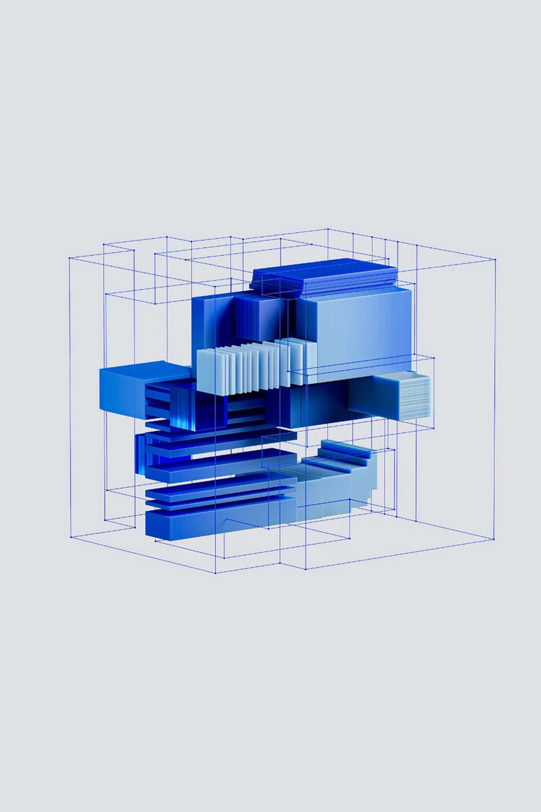
Growing IT and Network complexity means increased operational effort and cost
Old Model
Fragmented, reactive observability
New Model
Unified, intelligent observability
Automatic discovery of network, cloud topology and devices with fast data collection
Unified network observability: insights, scalable NetFlow, and synthetic monitoring across hybrid environments
Real-time, cross-domain visibility across the technology stack
Network Observability deployment and administration complexity
Tool sprawl and growing data volumes drive unpredictable observability costs
Siloed application, network, and infrastructure views
⟶
Notes:
The old model required - Extensive network setup and administrative operations.
New model get simplicity form SaaS delivery and auto-discovery of network and cloud network components
Old model: Multiple tools for each network domain (hybrid cloud, campus, etc),
New model - Unified network observability brings end-to-end capabilities that eliminate that need
Old model - Each of the IT stack domains has disjunct observability,
New model brings unified observability across IT stack: application, infrastructure and network layers
.

Slide 30
IBM CONCERT PLATFORM – BLUEPRINT FOR SUCCESS
Follow the blueprint to close network observability gaps
 | Stage 1: Understand → | Stage 2: Decide → | Stage 3: Act →
Concert Observe - Network Observability
 | Automatic discovery of network and cloud devices | Unified network observability | Accelerated incident investigation | Cross-domain correlation and impact analysis | Governed and guided remediation | Continuous recovery validation
IBM Concert platform
Notes:
Using the Understand, Decide, Act framework from earlier, this is the blueprint that Concert Observe follows to provide connected, intelligent observability.
First, Understand.
Concert Network Observability - automatically discovers network, cloud topology and devices on those networks with data collection in minutes
Concert Network Observability – delivers unified network observability with real-time insights, scalable NetFlow collection and synthetic monitoring across hybrid environments. All with an application-centric view of network performance. Capabilities: Device telemetry, NetFlow , Cloud VM & Network data , Network Synthetics , AI assistant for accelerated findings
Next, Decide.
Accelerated incident investigation - Turn raw network data into real-time, actionable insights and anomaly detection using analytics and scalable flow analysis. CNO correlates flows, network and application signals to accelerate root-cause isolation when services slow down .
Cross-domain correlation and impact analysis - Correlate application traces with network telemetry to accelerate issue isolation and root cause analysis across layers –”is the app or network layer”?
Finally, act.
Guided and governed remediation – proactively detect problems and act before and business application users experience service interruption. Capabilities: Synthetic testing , Continuous Monitoring , AI chat assistant , Anomaly detection , Policy-driven alerts . Turn recommended actions into coordinated remediation with human oversight. Proactive detection
Continuous recovery validation:
Confirm service has been restored and identify opportunities to prevent recurring issues.
Proactive performance assurance and continuous network health monitoring with synthetic tests
This blueprint turns network and cross-domain (App -> Infrastructure -> Network) observability from passive visibility into a connected operating model for coordinated response.

Slide 31
Solve your biggest observability challenge.
Take the next step with IBM Concert Observe.
See measurable operational improvement in 30–60 days.
01
02
03
Identify your use case
Validate measurable improvement
Expand with confidence
Start where network observability gaps are creating the greatest impact, then explore the relevant IBM Concert Observe capabilities in a focused demo.
Network and Application, Infrastructure performance
Critical end-to-end and hybrid cloud network performance
Use the self-serve sandbox to experience IBM Concert Network Observability and Concert Observe in your environment and validate outcomes that matter.
Faster root-cause analysis
Shorter detection and resolution time
Fewer user-impacting disruptions
Application-centric view of network performance
Extend to full Concert Observe capabilities across additional applications, infrastructure, networks, AI services, and critical user journeys as you demonstrate value.
↳ Contact your IBM team — ibm.com/products/concert/network-observability ibm.com/products/concert/observe
31
Notes:
So, where can you begin?
Let's start with the network observability gap creating the greatest operational or business impact. That could be network observability across multiple networks domains (hybrid cloud, campus, etc) for a unified network observability end-to-end application-centric. And all with the operational simplicity form SaaS delivery and auto-discovery of network and cloud network components. And as a contributor to the unified observability across IT stack: application, infrastructure and network layers.
Then we'd explore the unified network observability use case in a focused demo, and use the self-service sandbox to experience Concert Network Observability and Concert Observe for yourself.
It's critical to define success upfront using measures that matter to your organization, such as faster root-cause analysis, shorter resolution times, fewer user-impacting disruptions, and application-centric view of network performance
From there, we can expand across other use cases as you demonstrate value.

Slide 32
Thank you
© 2026 International Business Machines Corporation
IBM and the IBM logo are trademarks of IBM Corporation, registered in many jurisdictions worldwide. Other product and service names might be trademarks of IBM or other companies. A current list of IBM trademarks is available on ibm.com/legal/copyright-trademark.
This document is current as of the initial date of publication and may be changed by IBM at any time.
Statements regarding IBM’s future direction and intent are subject to change or withdrawal without notice, and represent goals and objectives only.
THIS DOCUMENT IS DISTRIBUTED “AS IS” WITHOUT ANY WARRANTY, EITHER EXPRESS OR IMPLIED. IN NO EVENT, SHALL IBM BE LIABLE FOR ANY DAMAGE ARISING FROM THE USE OF THIS INFORMATION, INCLUDING BUT NOT LIMITED TO, LOSS OF DATA, BUSINESS INTERRUPTION, LOSS OF PROFIT OR LOSS OF OPPORTUNITY.
Client examples are presented as illustrations of how those clients have used IBM products and the results they may have achieved. Actual performance, cost, savings or other results in other operating environments may vary.
Not all offerings are available in every country in which IBM operates.
It is the user’s responsibility to evaluate and verify the operation of any other products or programs with IBM products and programs.
The client is responsible for ensuring compliance with laws and regulations applicable to it. IBM does not provide legal advice or represent or warrant that its services or products will ensure that the client is in compliance with any law or regulation.
IBM Concert platform

Slide 34
Concert Protect
Notes:
So let’s double click into the challenge we’ve already started to lay the foundation for with Concert Protect, and see how the new operating model changes things in this context

Slide 35
50,000 vulnerabilities tomorrow. What do you fix first?
Old Model
New Model
50,000 findings
~40% CVSS 7+ = 20,000 to triage
Weeks of manual investigation
50,000 findings, auto-analyzed
~500 proven exploitable (~1%)
Top 50 fixed first, by business impact
⟶
Notes:
This is really where the building blocks, meet reality. If 50,000 vulnerabilities appeared in your environment tomorrow, would you know which ones to fix first?
You have limited time and resources, so every decision means choosing what deserves action and what can wait.
For years, cybersecurity has largely been reactive. We find a vulnerability, score it, predict whether it might be exploitable, and then ask teams to investigate across a patchwork of disconnected tools.
That model was built for a different scale of problem. This is our opportunity to challenge it. Instead of relying on prediction after the fact, the new model is about using evidence across code, applications, infrastructure, runtime, and business context to prove what is actually exploitable and focus action there. You can see the difference that model makes just in the breakdown of the 50,000 vulnerabiltiies here, with the top 1% proven exploitable and the top 50 fixed first and prioritized based on business impact.
OLD
Traditional cyberssecurity approach is looking at the after effect, looks at the idea of prediction, disconeected tools, and this is our chance to challenge that.
For years, the playbook to vulnerability management was simple: find vulnerabilities, rank them, open tickets, and fix what you can. But over time, that created a backlog-driven model—more findings, more handoffs, and remediation happening later than anyone wants.
Now AI is speeding up discovery at an accelerated pace. Frontier models like Anthropic's Mythos can identify vulnerabilities faster and at far greater scale than human teams can realistically investigate or remediate, so the old model starts to break.
The shift is from managing a queue of vulnerabilities to understanding which risks actually deserve action first, and that’s what the new model on the right is designed to do.
CUT
For the last twenty years, vulnerability management has largely been built around one objective: finding more vulnerabilities.
That led to more scanners, more tools, and more findings—but it also created the operating model you see on the left: manual triage, disconnected ticket queues, fixes that happen late in the lifecycle, and security acting as a gate at the end.
As we all know, AI is now changing the economics of discovery. Frontier models like Anthropic's Mythos can identify vulnerabilities faster and at far greater scale than human teams can realistically investigate or remediate.
So finding vulnerabilities is no longer the hardest part.
The challenge is knowing which ones actually matter, what they put at risk, and how to fix them fast enough.
That requires a new model, and that is what we are going to discuss today.
Instead of fragmented tools, teams need one view across the estate. Instead of relying mainly on severity scores, they need AI-driven prioritization grounded in operational impact and proof of exploitability. Instead of handing findings off through ticket queues, they need remediation to be increasingly automated. And instead of adding security at the end, risk needs to be addressed throughout the SDLC.
That is the shift IBM Concert Protect is designed to enable: from finding more vulnerabilities to continuously understanding, prioritizing, and remediating the ones that matter most.

Slide 36
IBM CONCERT PLATFORM – BLUEPRINT FOR SUCCESS
Follow the blueprint for proactive risk reduction
 | Stage 1: Understand → | Stage 2: Decide → | Stage 3: Act →
Concert Protect
 | Unify vulnerability findings with application, code, infrastructure and runtime context | Understand where vulnerabilities exist and which applications and service | Prove whether a vulnerability is exploitable in your environment | Prioritize proven exposures based on exploitability and business context | Shift left to fix vulnerabilities directly in the developer IDE | Shift right to automate patching at scale in production
IBM Concert platform
Notes:
Taking that understand ,decide, act framework we talked about earlier, this is the blueprint Concert Protect follows for proactive risk reduction.
First, understanding what’s at risk by connecting vulnerability findings with application, code, infrastructure, and runtime context.
Then, deciding what matters. This is where our biggest differentiator comes in: proof of exploitability. Rather than just predicting what might be exploitable, Protect provides evidence of what can actually be exploited in your environment, so teams can prioritize with greater confidence.
And finally, acting by remediating earlier, orchestrating fixes across existing tools, and validating that the exposure has been reduced.
It’s a blueprint for understanding the risk, proving what matters, and taking action based on what is exploitable.

Slide 37

Measurable business outcomes​ with Concert Protect
2 weeks
hours
Accelerate remediation
→
Reduce end-to-end remediation time
From investigation to developer-ready fix
90
20 minutes
Patch faster
→
Reduce manual patching effort
Patch time per instance​
10x faster
Detect risk in
code
Fix issues directly in the developer workflow
Vulnerability fixes at the point of creation
IBM Concert platform
Notes:
And this is what that blueprint looks like when you translate it into measurable outcomes.
Across the remediation lifecycle, the goal is to take time and manual effort out of the process. IBM has reduced the path from investigation to a developer-ready fix from weeks to hours, while Deutsche Telekom reduced patching time from 90 minutes to 20 minutes per instance.
And when we move further upstream into the developer workflow, issues can be addressed at the point of creation, with our own internal teams seeing vulnerability fixes happen 10 times faster.
So whether it’s investigation, patching, or fixing risk in code, the common thread is reducing the time between finding risk and actually resolving it based on what is truly exploitable
Lower case m
Find minutes

Slide 38
Act before unproven risk impacts your business.
Take the next step with IBM Concert Protect.
A focused 30–60 day path from exposure to measurable risk reduction.
01
02
03
Identify your use case
Prove measurable risk reduction
Scale coordinated remediation
Start where exposure, remediation effort, or operational friction is greatest.
Exposure management
Automated patching
In-code risk detection
Software composition analysis
Certificate lifecycle management
Power infrastructure risk management
Validate Concert Protect in your own environment and measure outcomes that matter.
Fewer vulnerabilities requiring investigation
Faster remediation
Lower patching effort
Reduced backlog
Faster developer fixes
Extend Concert Protect across additional teams, use cases, and parts of the SDLC.
Security and AppSec
Development
Infrastructure
Operations
Power environments
Enterprise-wide remediation workflows
↳ Contact your IBM team — ibm.com/products/concert/protect
38
Notes:
So where can you begin?
First, identify the use case creating the biggest operational bottleneck.
For some organizations that's application vulnerabilities.
For others it's patching.
For others it's certificate management.
Second, run a focused proof of concept over thirty to sixty days using your own environment.
Success should be measured using metrics that matter to your business, such as remediation time, backlog reduction, or investigation effort.
Finally, expand gradually.
Concert is designed to work with the investments you've already made.
This isn't about replacing your existing security tools.
It's about making your teams more effective.
As I like to say:
Everyone else offers a better guess.
Concert Protect offers proof.

Slide 39
Thank you
© 2026 International Business Machines Corporation
IBM and the IBM logo are trademarks of IBM Corporation, registered in many jurisdictions worldwide. Other product and service names might be trademarks of IBM or other companies. A current list of IBM trademarks is available on ibm.com/legal/copyright-trademark.
This document is current as of the initial date of publication and may be changed by IBM at any time.
Statements regarding IBM’s future direction and intent are subject to change or withdrawal without notice, and represent goals and objectives only.
THIS DOCUMENT IS DISTRIBUTED “AS IS” WITHOUT ANY WARRANTY, EITHER EXPRESS OR IMPLIED. IN NO EVENT, SHALL IBM BE LIABLE FOR ANY DAMAGE ARISING FROM THE USE OF THIS INFORMATION, INCLUDING BUT NOT LIMITED TO, LOSS OF DATA, BUSINESS INTERRUPTION, LOSS OF PROFIT OR LOSS OF OPPORTUNITY.
Client examples are presented as illustrations of how those clients have used IBM products and the results they may have achieved. Actual performance, cost, savings or other results in other operating environments may vary.
Not all offerings are available in every country in which IBM operates.
It is the user’s responsibility to evaluate and verify the operation of any other products or programs with IBM products and programs.
The client is responsible for ensuring compliance with laws and regulations applicable to it. IBM does not provide legal advice or represent or warrant that its services or products will ensure that the client is in compliance with any law or regulation.
IBM Concert platform

Slide 41
Concert Optimize
powered by Turbonomic
Notes:
What we have just seen with Concert Observe is how Concert helps teams understand what is happening across applications, infrastructure, networks and user journeys.
But understanding the condition of the environment raises another question: are applications receiving the resources they need, at the moment they need them, without organizations paying for unnecessary capacity?
That is where Concert Optimize comes in.
Concert Optimize helps organizations continuously balance application performance, infrastructure capacity and cost. It connects changing application demand to available infrastructure, determines the best resource action and helps execute that action with the level of governance the organization chooses.
The objective is not simply to reduce infrastructure. It is to make sure critical applications have the resources they need while making better use of the capacity the organization already owns or pays for.
Transition:
“To understand why that matters, consider what current market data tells us about memory allocation.”

Slide 42
Costs keep rising. Capacity is harder to secure. How do you sustain application performance?
Old Model
Manual and reactive resource management
New Model
Continuous, application-driven optimization
Anticipate resource risk continuously
Automate policy-driven resource actions
Match resources to real-time application demand
Balance application performance, cost and resource efficiency automatically
React after utilization or performance problems
Manually tune resources
Overprovision GPUs
Manage infrastructure utilization
⟶
Notes:
This is really where the building blocks, we discussed earlier meet reality. If 50,000 vulnerabilities appeared in your environment tomorrow, would you know which ones to fix first?
You have limited time and resources, so every decision means choosing what deserves action and what can wait.
For years, cybersecurity has largely been reactive. We find a vulnerability, score it, predict whether it might be exploitable, and then ask teams to investigate across a patchwork of disconnected tools.
That model was built for a different scale of problem. This is our opportunity to challenge it. Instead of relying on prediction after the fact, the new model is about using evidence across code, applications, infrastructure, runtime, and business context to prove what is actually exploitable and focus action there. You can see the difference that model makes just in the breakdown of the 50,000 vulnerabiltiies here, with the top 1% proven exploitable and the top 50 fixed first and prioritized based on business impact.

Slide 43
IBM CONCERT PLATFORM – BLUEPRINT FOR SUCCESS
Follow the blueprint for continuous performance and cost optimization
 | Stage 1: Understand → | Stage 2: Decide → | Stage 3: Act →
Concert Optimize
 | Connect supply and demand of resources across your IT estate | Reveal performance and cost risk . | Determine the best resource actions | Prioritize actions with confidence | Automate approved resource actions | Keep applications continuously optimized
IBM Concert platform
Notes:
Concert Optimize begins by bringing application demand and infrastructure supply into the same decision model.
Under Understand, it connects utilization, capacity, performance and cost, then identifies where resources are overprovisioned, underused or constrained.
Under Decide, it evaluates the available actions—such as rightsizing, scaling, placement or capacity changes—and prioritizes them according to their expected business impact and the policies you have defined.
Under Act, those decisions can remain recommendations, move through an approval workflow or be automated within established guardrails.
The final step is validation. Concert confirms the effect on performance, efficiency and cost, then repeats the cycle as conditions change.
This is what makes optimization continuous rather than another one-time assessment.”
Transition to next slide
“And when that decision loop operates continuously, the value shows up in the scale, speed and financial impact of infrastructure decisions.”

Slide 44
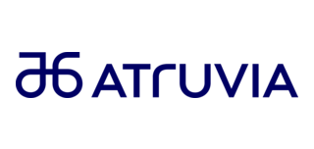

Measurable business outcomes​ with Concert Optimize
≈ 45,000
Scale infrastructure operations
Automated resourcing actions per month
60%
Accelerate resourcing decisions with confidence
faster resourcing decisions
​
20%
Make existing infrastructure capacity go further
reduction in physical servers within 18 months
IBM Concert platform
Notes:
These results demonstrate three dimensions of the Concert Optimize value story.
First is capacity and operational scale.
IBM’s CIO organization achieved a 3.8-terabyte decrease in cumulative memory limits while using automation to execute approximately 45,000 resourcing actions every month.
That volume of continuous adjustment would be extremely difficult to execute through manual intervention.
Second is decision speed and efficient allocation.
BlueIT reduced the time required to execute resourcing decisions by 60%. For one client, it also achieved a 10% reduction in memory and CPU over-allocation.
Third is financial and business impact.
Maximus achieved 113% year-one return on its software licensing investment while mitigating 78 production performance risks.
The common thread is not visibility alone.
Concert Optimize connects application demand, infrastructure supply, policy and cost to a specific resource action and then validates the result.
That enables organizations to reclaim capacity and improve infrastructure economics without compromising application performance.
Transition:
“The field does not need to begin with a broad transformation. The adoption motion can start with one funded resource decision that is already creating measurable business pressure.”

Slide 45
Start with the decision creating the most pressure.
Prove value. Deploy with governance.
Expand what works.
01
02
03
Start with your biggest pain
Quantify the opportunity
Deploy, govern, and expand
Choose a capacity or cost decision with visible business impact.
Examples:
Memory-capacity constraints
Hardware refresh decisions
Kubernetes efficiency
Cloud rightsizing
AI infrastructure utilization
Connect the relevant data and demonstrate the projected performance, capacity and cost impact.
Examples:
Capacity that can be reclaimed
Performance risks that can be prevented
Infrastructure purchases that can be delayed
Begin with recommendations, introduce approvals and automate the actions the client trusts.
Expansion areas:
Data center
Kubernetes
Public cloud
AI infrastructure
↳ Contact your IBM team — ibm.com/products/concert/optimize
45
Notes:
The recommended approach is to start with one funded priority where the business impact is already visible.
That could be a memory-capacity constraint, an upcoming hardware refresh, Kubernetes efficiency, cloud rightsizing or AI infrastructure utilization.
The first step is to identify the decision creating the greatest pressure.
The second step is to connect the relevant data and quantify the opportunity in the client’s own environment.
That means demonstrating the capacity that could be reclaimed, the performance risks that could be prevented and the infrastructure purchases that might be delayed.
The third step is to deploy with the appropriate governance.
Clients can begin with recommendations, introduce approvals where required and automate only the actions they trust.
Once value has been demonstrated, the same approach can expand across data center, Kubernetes, public cloud and AI infrastructure.
For sellers, this creates a clear adoption motion: start with a funded infrastructure decision, prove the value using the client’s own data and expand from demonstrated results.
Close:
“Concert Optimize enables organizations to make resource decisions continuously, with the right balance of performance, capacity, cost and control.”
Optional leadership question:
“Which resource or capacity decision gives our sellers the strongest entry point with clients today?”

Slide 46
Thank you
© 2026 International Business Machines Corporation
IBM and the IBM logo are trademarks of IBM Corporation, registered in many jurisdictions worldwide. Other product and service names might be trademarks of IBM or other companies. A current list of IBM trademarks is available on ibm.com/legal/copyright-trademark.
This document is current as of the initial date of publication and may be changed by IBM at any time.
Statements regarding IBM’s future direction and intent are subject to change or withdrawal without notice, and represent goals and objectives only.
THIS DOCUMENT IS DISTRIBUTED “AS IS” WITHOUT ANY WARRANTY, EITHER EXPRESS OR IMPLIED. IN NO EVENT, SHALL IBM BE LIABLE FOR ANY DAMAGE ARISING FROM THE USE OF THIS INFORMATION, INCLUDING BUT NOT LIMITED TO, LOSS OF DATA, BUSINESS INTERRUPTION, LOSS OF PROFIT OR LOSS OF OPPORTUNITY.
Client examples are presented as illustrations of how those clients have used IBM products and the results they may have achieved. Actual performance, cost, savings or other results in other operating environments may vary.
Not all offerings are available in every country in which IBM operates.
It is the user’s responsibility to evaluate and verify the operation of any other products or programs with IBM products and programs.
The client is responsible for ensuring compliance with laws and regulations applicable to it. IBM does not provide legal advice or represent or warrant that its services or products will ensure that the client is in compliance with any law or regulation.
IBM Concert platform

Slide 48



Seamlessly integrate data & signals into domain knowledge
UNDERSTAND
200+ integrations across IBM and 3rd party tools
Application
IBM Concert platform
Security
Observe
Protect
Optimize
-
-
-
Connect signals across domains,
environments and vendors​
Understand dependencies, trends
and root-cause​
Build and maintain context as
systems evolve
Infrastructure
DATA + SIGNALS
Network
Operate
Resilience
Workflows
ITSM, alerts and incidents
Each Concert capability applies domain-specific data and intelligence
IBM Concert platform
IBM Concert platform
Notes:
Understand is the first building block in the Concert operating model. It connects signals across your technology estate to create shared context across applications, infrastructure, networks, security, and service management.
With more than 200 integrations across its capabilities and an open ecosystem, Concert can bring in relevant data and signals from the IBM and third-party tools you already use. This gives each Concert capability a broader understanding of your environment.
Today, that shared context powers cross-domain agentic workflows across Concert Observe and Optimize — helping these capabilities work together with a more complete understanding of what is happening and why it matters.
Our direction is to extend this coordination model across additional IBM technologies and third-party tools and agents — expanding the ecosystem from contributing context to participating in agentic workflows.

Slide 49










DECIDE
Know what matters across domains, with context
Unified AI Assistant
Single interface for operational direction, questions, insights, and actions​
Acts as the operational manager, synthesizing expertise
across domains to drive coordinated decisions​
Coordinator Agent
Specialized agents that investigate, prioritize,
and execute across operational domains​
Capability Agents
Observe
Protect
Optimize
Incident Investigation
Secure Coder
SLO
and more…
Domain Knowledge
Data access layer
IBM Concert platform
Notes:
Once Concert has context, the next question is: what matters most across the environment, and what should happen next?
That’s what Decide is about.
Users interact through the Unified AI Assistant to investigate issues and review recommendations.
Behind it, Capability Agents contribute specialized expertise from observability, security, infrastructure optimization, and other operational domains.
The differentiation comes from the Coordinator Agent. It brings those perspectives together, maintains shared context, and evaluates cross-domain tradeoffs — not just what is best for one team or tool.
For example, an infrastructure change that reduces cost could affect the performance or security of a critical service. Concert helps teams account for those dependencies, policies, and business impacts so they can prioritize what matters across the entire environment.

Slide 50

Coordinate governed action across domains
ACT
Agents and Sensors
- Single agent
- OTEL
Application Delivery
- IDE remediation
- Patch application
Security Management
- Secrets lifecycle management
- Dynamic secrets generation
Infrastructure and Resource Optimization
- Infrastructure provisioning and rightsizing
- Workload placement and scaling
ITSM, Observability & Monitoring
- Automated incident creation
- Service recovery validation
IBM Concert platform
Notes:
Making the right decision is only half the challenge. It creates value only when something actually happens.
That’s what Act is about: turning a coordinated decision into governed execution across domains.
Concert can coordinate application and security actions such as IDE remediation, patching, and secrets management. It can also coordinate Optimize actions — including infrastructure provisioning, rightsizing, workload placement, and scaling — and ITSM and observability actions such as incident creation and service recovery validation.
Execution happens through the systems already responsible for the work: IDEs, Ansible, and Terraform for remediation and provisioning; Optimize and Turbonomic for resource actions; ServiceNow for incident workflows; and Observe and Instana for validating recovery.
Policies, approvals, and guardrails determine what can happen automatically and where people remain in control. Over time, agents can accelerate more of this execution within those controls.
The resulting telemetry flows back through agents, sensors, and Open Telemetry, refreshing Concert’s understanding and informing the next decision.

Slide 51
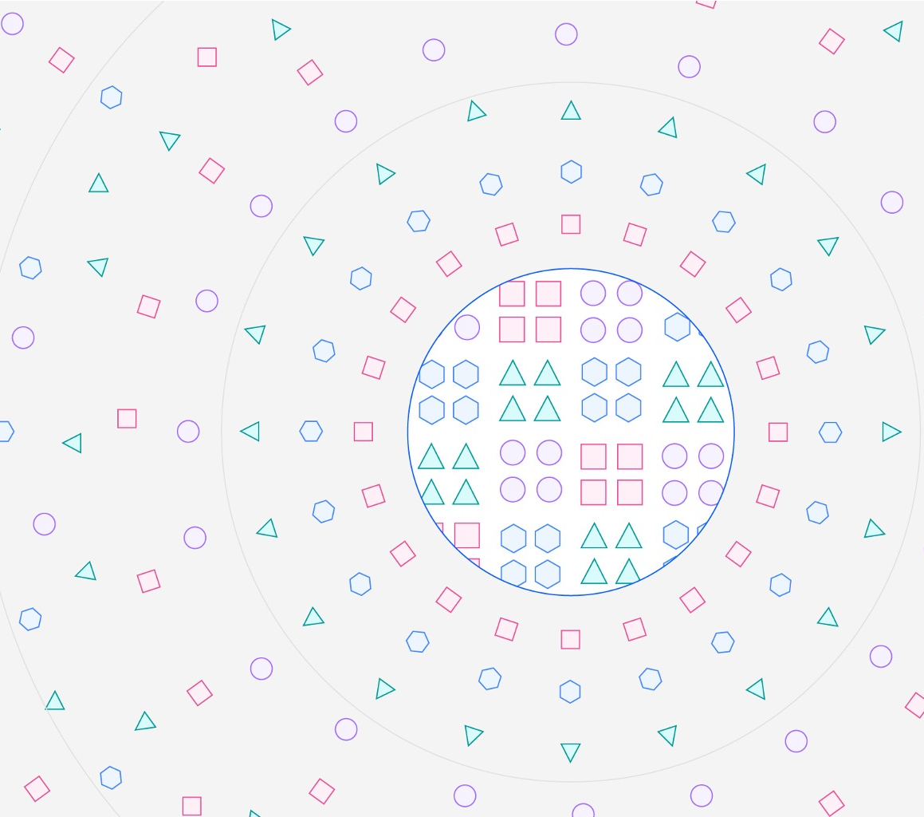
IT complexity is compounding across every operational domain
Autonomous activity expands.
Cross-domain dependencies multiply.
Operational pressure intensifies.
150,000+
Projected AI agents in use at an average global Fortune 500 enterprise by 2028 — up from fewer than 100 in 2025.
Source: Gartner, “Gartner Identifies Six Steps to Manage AI Agent Sprawl,” April 28, 2026.
IBM Concert platform
Notes:
Quick context. IT environments have always been complex, and that complexity is compounding across every operational domain. AI agents add another layer — not simply more software to monitor, but systems that can observe, decide, and act on their own.
Gartner projects that an average global Fortune 500 enterprise will have more than 150,000 agents in use by 2028, up from fewer than 15 in 2025.
The number is striking, but the operational implication matters more.
Each agent can access data, call tools, generate activity, and trigger changes across applications, infrastructure, security, and service management. Even when individual agents work as intended, their combined activity creates a much larger and faster-moving environment to understand and govern.
As autonomous activity expands, cross-domain dependencies multiply. An action taken in one part of the environment can affect performance, risk, cost, or resilience somewhere else.
Without shared context and coordination, operations teams become the manual coordination layer — reconciling signals, decisions, and controls after the fact.

